Slide 1
User Guide to CADRE’s Cultural & Linguistic Competence Assessment for DR Systems
Phase 4:
Action Planning

Slide 2
Purpose
“Our goals can only be reached through a vehicle of a plan, in which we must fervently believe, and upon which we must vigorously act. There is no other route to success.”
-Pablo Picasso

Slide 3
Learning Objectives
Following this webinar, you will gain an understanding about:
the importance of action planning
steps for consideration

Slide 4
Action Planning
Action planning is about choosing which path will help you achieve your goals and then mapping out that path.

Slide 5
Benefits of Action Planning
Action Planning:
brings clarity to the work, and
results in a roadmap that will help the team…
focus their efforts
delineate responsibilities to create a shared workload
outline timelines, and
take action.
Action planning brings order to chaos!

Slide 6
Step 1
Select no more than 2-3 indicators from the assessment tool to focus on.
Assess agency’s capacity
Add priorities as needed
Adopt a continuous improvement approach

Slide 7
Step 2
Determine one measurable and achievable goal per selected indicator.

Slide 8
Action Planning Considerations
What needs to happen in order to achieve your goal?
What activities would be implemented?
Is there a sequential order that needs to occur?
What resources, knowledge, and skills will be required to implement activities?
How will you know if you achieved your goal?

Slide 9
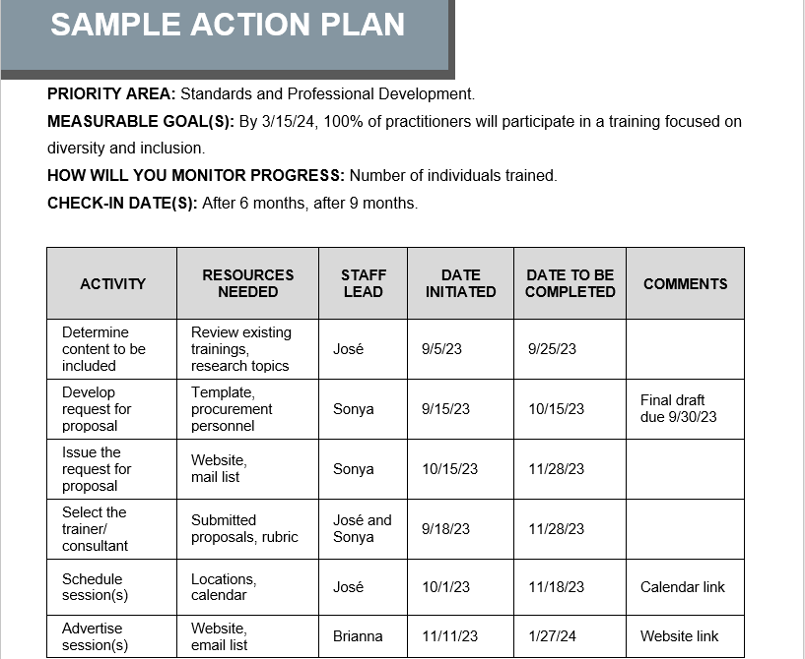
Action Planning Example

Slide 10
Step 3
Assign a staff lead for each goal.

Slide 11
Step 4
Identify a completion date.

Slide 12
Step 5
Check in along the way.

Slide 13
Check-Ins Allow the Team to:
Celebrate accomplishments.
Reassess workloads.
Adjust action plans as needed.
Monitor progress.

Slide 14
Have questions or need assistance?
Contact us at:
cadre@directionservice.org

