Slide 1

User Guide to CADRE’s Cultural & Linguistic Competence Assessment for DR Systems
Phase 1:
Getting Started

Slide 2
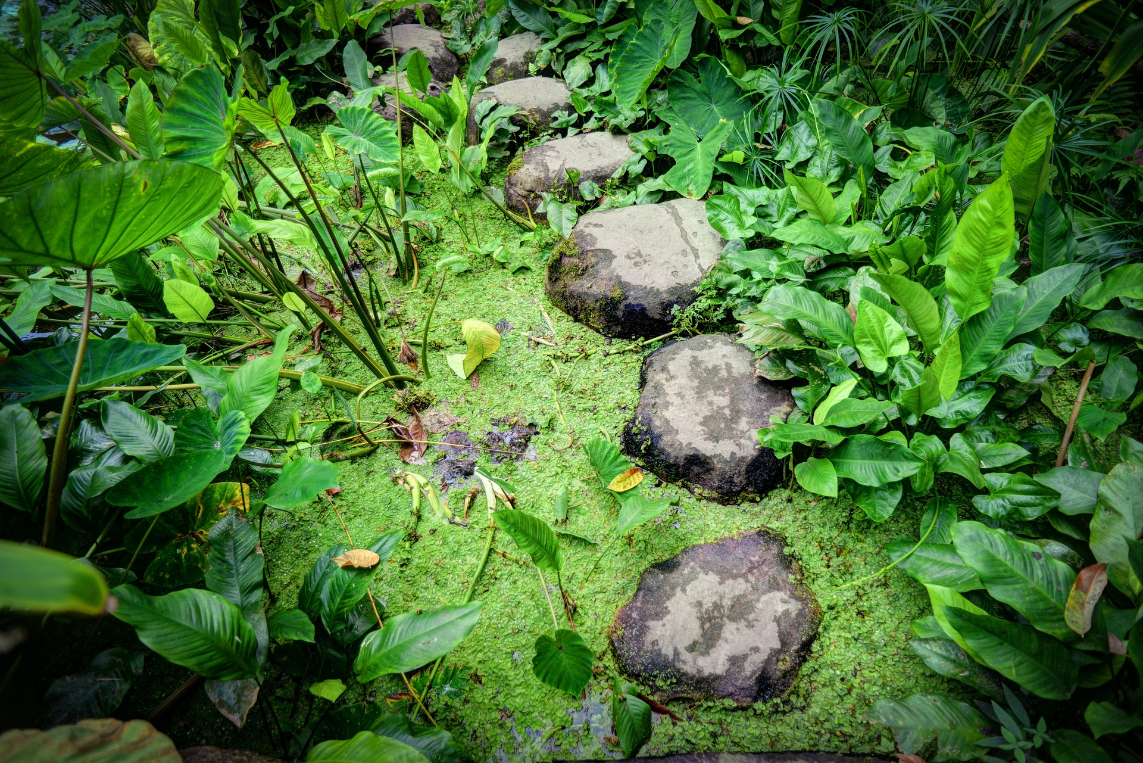
Purpose
“A journey of a thousand miles begins with a single step.” –Lao Tzu

Slide 3
Objectives
Following this webinar, you will have a better understanding about:
key considerations for creating a strong team;
the value in developing personal cultural and linguistic competency;
the importance of leadership support and the role of team leaders; and
how successful CLC assessment teams function.

Slide 4

A Team Approach
A team approach encourages diverse perspectives and robust discussion.

Slide 5

How to Create a Strong Team
Intentionally expand the diversity of your team.
Consider including those who:
  are interested in and committed to cultural and linguistic competence,
  share a common desire to effect change, and
  can help foster a respectful environment conducive to sharing diverse perspectives and ideas.

Slide 6

Expanding CLC Capacity of Team
Provide opportunities for team members to engage in personal development activities related to CLC.
If needed, seek support from an internal or external content expert who can help guide or support the work.

Slide 7
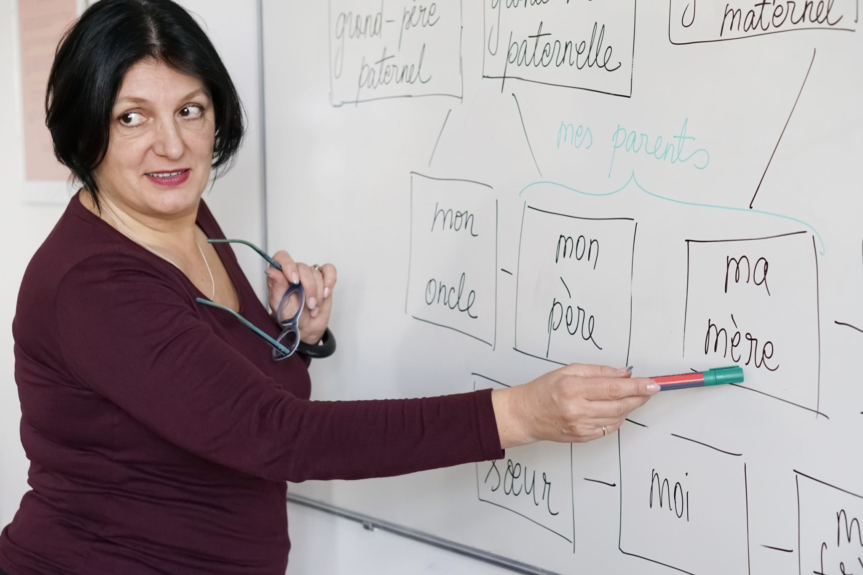
Identifying Team Leaders
A coordinator can:
  facilitate or help identify a facilitator
  handle meeting logistics and activities
  communicate process and progress with leadership, staff, and stakeholders
  document conversations and status updates
  keep the assessment process on track
  identify opportunities to bring data and perspectives to the team
  celebrate successes
  keep the team moving forward

Slide 8

Leadership Support is Critical
Ongoing communication with leadership will be essential to the team's success.

Slide 9

Dedicate Time
Allocate sufficient time to:
Engage in meaningful dialogue
Reflect upon the process and content
Gather additional data and perspectives
Reach out for support
Communicate with team, leadership and stakeholders
Backtrack if necessary

Slide 10

Successful Teams Reflect
Highly effective teams reflect individually to determine where biases reside.
REFLECT

Slide 11

Successful Teams
Engage
ENGAGE

Slide 12
What Do We Mean by “Engage”?
Connect with stakeholders in meaningful conversations that help you understand their experiences.
These connections will help you open doors for future collaboration.
ENGAGE

Slide 13
What Do We Mean by “Diverse” Populations?
Individuals, families, and communities who do not identify with or fit into the dominant cultural norm;
Are often underserved; and
May experience barriers to access and resources because of cultural differences.
ENGAGE

Slide 14
Considerations for Engagement
Teams should be intentional about stakeholder engagement and consider:
  the purpose
  how stakeholders will be identified
  the extent of stakeholder involvement in the system improvement process.
ENGAGE

Slide 15

Successful Teams Use Data
USE DATA

Slide 16
Data and the User’s Experience
Collecting and using a variety of data allows for fact-based discussions about the current state of your system.
Analyze child-specific data.
Use demographic user data to get a clear understanding of system use.
Dive into individual user experiences.
  Barriers accessing and using system
  Feedback on specific materials or processes
  Preferred delivery mechanisms
USE DATA

Slide 17
Ways to Collect Data
Seek to understand lived experiences through:
  focus groups or interviews
  surveys
  gather information in intake process
  follow-up calls or exit surveys
  listening sessions
  others
Work with cultural brokers to assist in connecting with families
USE DATA

Slide 18
Successful Teams Examine
Highly effective teams examine the experiences of diverse cultural and linguistic groups when navigating systems that primarily have been designed by and for the cultural majority.
EXAMINE

Slide 19

Successful Teams Build Relationships
BUILD

Slide 20

Have questions or need assistance?
Contact us at:
cadre@directionservice.org

