Slide 1
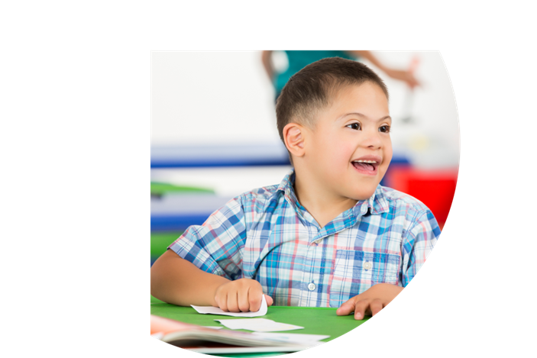
Working Together Online Learning Series www.cadreworks.org/working-together
Working Together Online Learning Series www.cadreworks.org/working-together
Educators and Family Members
supporting students with IEPs
Educators and Family Members
supporting students with IEPs
Learn strategies for working together
and through conflict.
Topics
Topics
Trust
IEP Meetings
Listening
Emotions
Conflict Resolution
Focusing on Interests
Trust
IEP Meetings
Listening
Emotions
Conflict Resolution
Focusing on Interests
What others are saying:
What others are saying:
“…a very worthwhile series”
“I especially love that it is for parents and educators” “…very relatable to both educators and family members”
“…a very worthwhile series”
“I especially love that it is for parents and educators” “…very relatable to both educators and family members”

Slide 2
Working Together Online Learning Series
Educators and Family Members
supporting students with IEPs
Learn strategies for working together
and through conflict.
Join Us!
Who:
When:
Where:
Trust
IEP Meetings
Listening
Emotions
Conflict Resolution
Focusing on Interests
www.cadreworks.org/working-together

