Slide 1
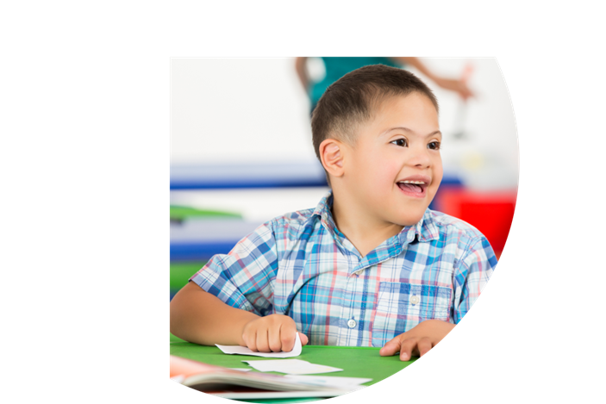
Working Together Online Learning Series www.cadreworks.org/working-together
Working Together
Online Learning Series
Educators and Family Members
supporting students with IEPs
Learn strategies for working together
and through conflict.
Topics
Trust
IEP Meetings
Listening
Emotions
Conflict Resolution
Focusing on Interests

