Slide 1
Perfect Together:
Aligning and Leveraging SEAs and Parent Centers in Shared Work
Helen Post and Kim Fratto
January 10, 2018
2:30 pm – 3:45 pm ET (11:30-12:45 PT)
Note: The presentation is currently available on the CADRE website http://www.cadreworks.org/events/perfect-together-aligning-and-leveraging-state-education-agencies-and-parent-centers-shared
Technical Stuff:
Please enter any questions or technical difficulties into the questions box.
Thank you, in advance, for taking the time to respond to the brief survey at the end of the webinar!

Slide 2


Perfect Together:
Aligning and Leveraging SEAs and Parent Centers in Shared Work
Kim K. Fratto, M.Ed.
Education Coordinator, Special Education Services Section, Utah State Board of Education
Helen W. Post
Executive Director, Utah Parent Center
Utah’s Parent Training and Information Center

Slide 3


Perfect together…
Trying stuff changes the world.
Unknown

Slide 4
Historical Relationship
Utah Parent Center (UPC) and the Utah State Board of Education (USBE) have been actively working together since 1983 when the UPC received their initial PTI grant.
Relationship has continued to develop and grow through contact, cooperation, and collaboration.
Aligning and leveraging resources in our shared work is what we have always done.
Notes:
HWP
We want to begin by briefly introducing:
The Utah Parent Center (UPC) – which is Utah’s federally funded Parent Training and Information Center – or PTI – serving parents of children youth and young adults with disabilities AND
the Utah State Board of Education (USBE) – which is Utah’s State Education agency – or SEA – that provides leadership and support to local education agencies – or LEAs – as they serve students with disabilities.

Slide 5
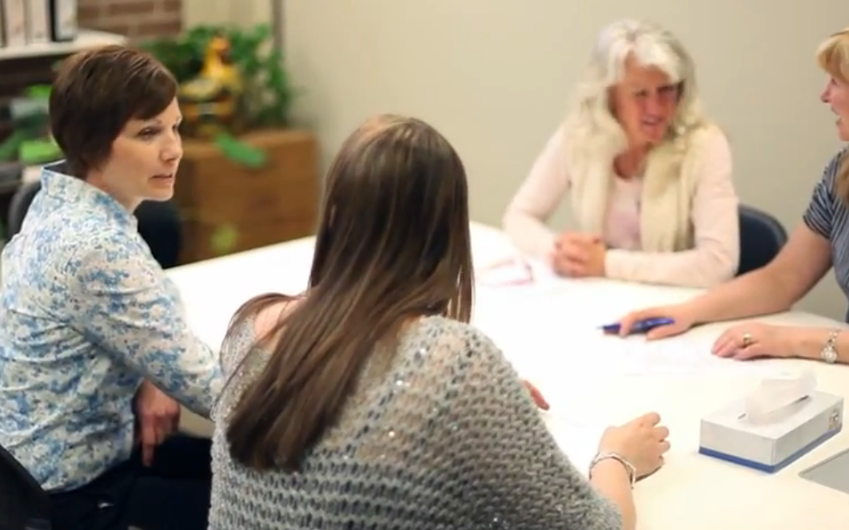
What Helps
Our Partnership…
Proximity
We know each other
Communication
Many staff involved – sustainability of the relationship
Trusting and being trustworthy
Mutual respect
Culture based on the belief that we can’t do the work without each other!

Slide 6

Building on the Relationship –
Authentic Engagement
Implemented a different way of defining collaboration and engaging stakeholders by moving beyond “informing” to creating opportunities for interaction, building consensus, and sharing leadership opportunities.
Relationships across stakeholder groups are aligned with The Collaboration Continuum.

Slide 7
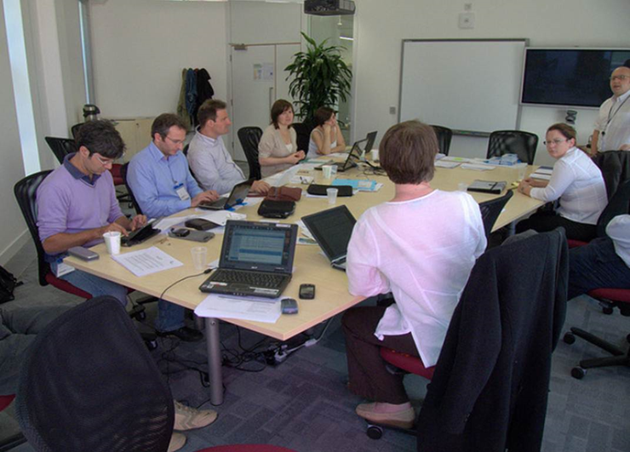
What Helps Build Authentic Engagement…
Using a facilitator
Not starting over, but building on what you do well and committing to different kind of collaboration
Establishing common understanding and getting buy-in
Aligning and leveraging multiple initiatives to be complementary and to maximize efforts

Slide 8
Collaboration Continuum Graphic
Refer to your handout

Slide 9
Collaboration Continuum
Contact
Cooperation
Coordination
Collaboration
Convergence
Investment, Risk, and Benefit

Slide 10
Utah’s Activities
Along the Collaboration Continuum
Open honest dialogue to engage parents
  Focus groups to gain stakeholder feedback
  Information sharing
  Panel discussions
  Facilitated discussions
  Open invitation to provide feedback
  More informed parent perspective and voice being incorporated in planning and implementation of initiatives
Contact

Slide 11
Utah’s Activities
Along the Collaboration Continuum
  Shared Goals
    Sharing data (UPC to USBE and USBE to UPC)
    Cross-training of staff
    Identifying and working on common goals
    Open invitation to participate in professional development
  Leads to a common language and shared understanding of process, policy, activities and needs for all stakeholders involved
Cooperation

Slide 12
Utah’s Activities
Along the Collaboration Continuum
Shared Achievement of Goals
    Direct involvement in plans, grant-writing, advisory roles, implementation responsibilities, etc.
    Aligning activities with USBE and UPC shared goals
    Reporting shared activities that support shared work
    Collaborative development of materials and presentations
  Increased capacity to identify, understand and implement relevant training for stakeholders across topics and initiatives
Coordination

Slide 13
Utah’s Activities
Along the Collaboration Continuum
Shared Resources
    Funding to support UPC activities
    UPC active on implementation and state leadership teams
    High level of trust in the expertise of each agency
    Co-presentations to LEA and stakeholder groups
    Dissemination of materials for parent and LEA use
    LEA specific collaboration to increase parent participation
    Problem-solving and joint implementation of strategies to address areas of need
  Increased parent awareness and knowledge about resources available to improve student outcomes
Collaboration

Slide 14
Utah’s Activities
Along the Collaboration Continuum
“Synthetic Infrastructure”
    USBE and UPC have an ongoing, “extensive, engrained, and assumed” relationship that is part of the infrastructure
    Relationship is planned and purposeful and requires ongoing maintenance
    Invested in mutual success
    Problem-solve and jointly implement strategies
  A continued collaboration that withstands the test of time and changes in personnel
Convergence

Slide 15

Other Collaborative Efforts
Indicator 8-Parent Survey
State monitoring team
Annual UMTSS conference
State Systemic Improvement Plan (SSIP) for Parts B and C
Co-sponsor training events
Parent Book Studies
Parent handbooks (resource guides)
Co-presentations at conferences

Slide 16

Working on “Perfect”:
Utah’s Areas to Improve
Contact: Increase our reach bringing in new families and stakeholders
Cooperation: Build supports that lead to increased cooperation among the LEA staff, parents and students
Coordination: Support LEAs in educating parents about UMTSS
Collaboration: Increase family engagement on all levels
Convergence: What does this look like? The parent to school relationship is extensive, engrained and assumed. Parents are involved at all levels. Communication is multi-directional, valued and consistent.

Slide 17

Questions? Thoughts?

Slide 18
Perfect together…
Trying stuff changes the world.
Unknown

Slide 19

Here’s to working together “perfectly”!

Slide 20
Thank you! Contact us…
Kim K. Fratto, M.Ed.
Education Coordinator, Special Education Section
Utah State Board of Education
801-538-7716
kim.fratto@schools.utah.gov
Helen W. Post
Executive Director, Utah Parent Center
801-272-1051
helenp@utahparentcenter.org

Slide 21

Thank you for joining us!
Please take a few minutes to respond to this brief survey about your experience:
Webinar Survey https://www.surveymonkey.com/r/SEA-ParentCenter-SharedWork

Slide 22

Upcoming Webinar
Skilled Dialogue: Minding and Mining the Riches of Differences
March 6, 2018 11:30-12:45 PST
Presenters:
Isaura Barrera, Ph.D. and
Lucinda Kramer, Ph.D.
Registration Now Open – Check the CADRE Website!

