Slide 1
A Split in the Road: Issues, Outcomes, and Remedies Between and Within State Complaint and Hearing Officer Decisions Perry Zirkel, Lehigh University June 6, 2017 2:30 pm – 3:45 pm ET (11:30-12:45 PT) Note: The presentation is currently available on the CADRE website http://www.cadreworks.org/events/split-road-issues-outcomes-and-remedies-between-and-within-state-complaint-and-hearing
Technical Stuff:
Please enter any questions or technical difficulties into the questions box.
Thank you, in advance, for taking the time to respond to the brief survey at the end of the webinar!

Slide 2
The IDEA Decisional Avenues—Complaint Procedures and Impartial Hearings
Perry A. Zirkel
© 2017
Lehigh University

Slide 3
Introduction:
The IDEA provides two decisional dispute-resolution alternatives—the complaint procedures (CP) and hearing officer (HO) “avenues.” The professional literature provides far less attention to CP (e.g., Colker, 2014; Suchey & Huefner, 1998) than to HO, and no empirical examination comparing the content and outcomes of these two alternatives.

Slide 4
Introduction (cont.):
To serve as a significant first step for filling this informational gap, this webinar shares the results of an empirical analysis comparing the CP and HO avenues with regard to issue categories, outcomes, and remedies. The random sample of decisions was from five of the states with the most CP and HO activity.

Slide 5
Introduction (cont.):
Part I provides a brief comparison of these two decisional “avenues.”
Part II provides an overview of the methodology for the analysis.
Part III provides the results for the total sample and the five state subsamples.
Part IV provides discussion questions for policymakers and practitioners.

Slide 6
Part I:
Brief Comparison

Slide 7
Basic Similarities:
• both are rather special to the IDEA
• both are administrative and decisional
• both are complaint-initiated and, within a tight timeline, require a written decision
• the subject matter jurisdiction is very similar, including (according to OSEP policy) not only procedural but also substantive issues
• both have broad, equitable remedial authority

Slide 8
Basic Differences:
HO
adjudicative
parent or district filing
burdensome for parties
“look back” period of two years “KOSHK”
open concurrent judicial
CP
investigative
open filing
minimal burden for complainant
one year period no judicial appeal
in most states

Slide 9
Previous Research:
HO: extensive, including characteristics, issue categories, outcomes, and remedies.
CP: relatively minimal, including Suchey & Huefner (1998) survey, Colker (2014) Ohio CP outcomes analysis, Zirkel (2016) comparison, and CADRE (2016) national frequency analysis – negligible treatment in special ed. law texts

Slide 10
Part II:
Methodology

Slide 11
Sample and Coding:
• 5 among the most active “states” (due to difficulty of obtaining nationwide sample)
• random sample of 50 CP and 50 HO decisions from each state (total=5x100=500)
• coding protocol, including “issue categories” and their outcomes (in favor of parent or district)
• pilot phase for interrater reliability

Slide 12
Unit of Analysis:
Primary: issue categories (ICs), including
• child find; eligibility
• FAPE-procedural, FAPE-substantive & FAPE-implementation
• LRE
• discipline
• tuition reimbursement & compensatory education
Secondary: cases on a best IC per case basis

Slide 13
Part III:
Results

Slide 14
HO-CP Comparison:
• Frequency:
- average of 2 ICs per case for both avenues
• Outcomes in terms of parents’ success rate:
- Overall ICs: 24% for HO and 50% for CP
- Overall cases: 32% for HO and 66% for CP
- District-initiated ICs: 8% for HO

Slide 15
HO-CP Comparison (cont.):
Relatively high-frequency ICs:
- HO: FAPE-substantive
- CP: FAPE-procedural and FAPE-implementation
Relatively high parent success:
- CP: procedurally oriented ICs and FAPE-
implementation
Relatively high-frequency remedies:
- HO: tuition reimbursement
- CP: delegated compensatory education

Slide 16
CP-HO Comparison (cont.):
Qualitative observations regarding CP:
• negligible use of court decisions
• compliance-oriented, strict analysis for FAPE-procedural and FAPE-implementation
• sua sponte extension beyond complaint Ics and beyond complainant
• broader but shallower remedies (e.g. , policy review/revision and personnel training)

Slide 17
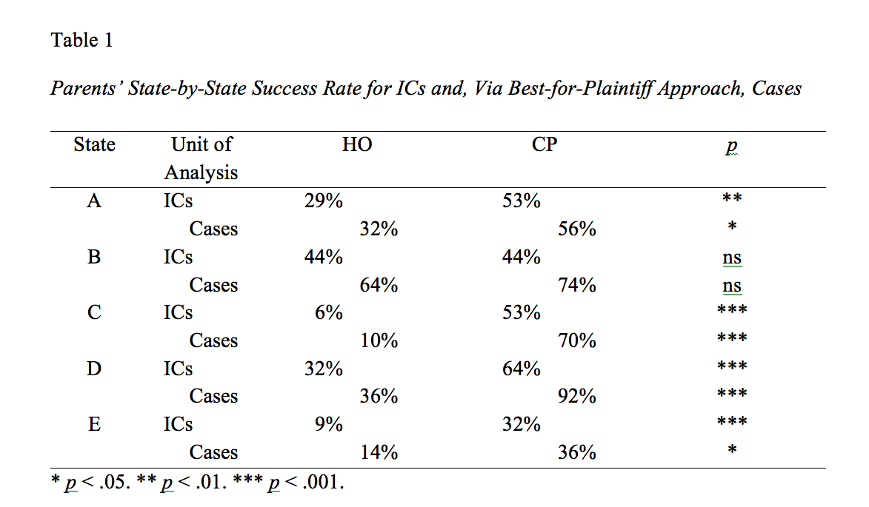
Inter-State Comparison:

Slide 18
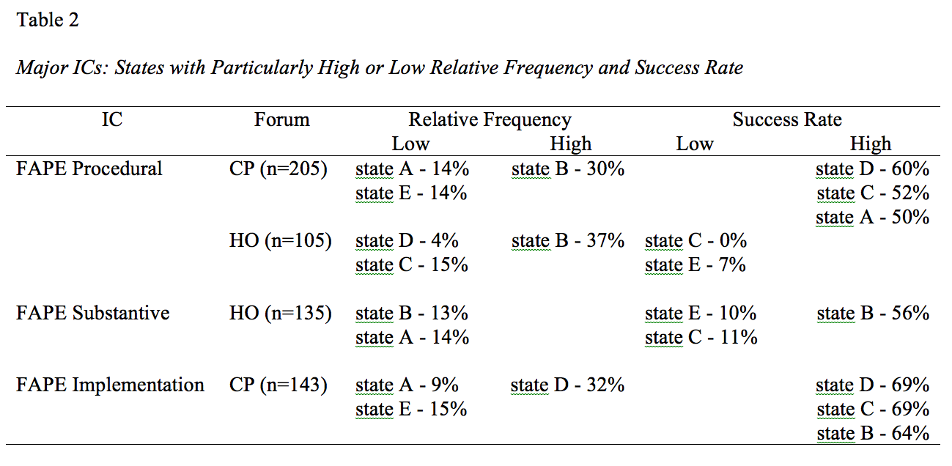
Inter-State Comparison:

Slide 19
Inter-State Comparison:
Notable state peculiarities for CP:
- state A: two-step analysis for FAPE-procedural and corrective actions as “recommendations”
- state B: minimum amount for delegated compensatory education
- state D: prospective order of memo to staff

Slide 20
Inter-State Comparison:
Notable state peculiarities for HO:
- state A: accounting for half of the district-initiated ICs
- states C and D: conflating issues from parents’ complaint into broad IC, such as FAPE-procedural
- state D: non-unitary approach for FAPE-substantive (contingent upon limited prospective revision in IEP)

Slide 21
Part IV:
Discussion

Slide 22
Practical and Policy Questions:
• Why do parents not utilize the CP avenue much more frequently than the HO alternative?
• Would increasing the harmony of the CP approach with that of HO (e.g., use of court decisions) be worth the trade-offs, including selection and training of personnel?
• Why is the inter-state variability so notable, and is it, on balance, acceptable?

Slide 23
References
CADRE. (2016). Trends in dispute resolution activity under the Individuals with Disabilities Education Act. Retrieved from http://www.directionservice.org/cadre/TrendsinDisputeResolutionundertheIDEA.cfm
Colker, R. (2014). Special education complaint resolution: Ohio, Ohio State Journal on Dispute Resolution, 29, 371– 406.
Suchey, N., & Huefner, D. S. (1998). The state complaint procedure under the Individuals with Disabilities Education Act. Exceptional Children, 64, 529–542.
Zirkel, P. A. (in press). The two dispute decisional processes under the Individuals with Disabilities Education Act: An empirical comparison. Connecticut Public Interest Law Journal.

Slide 24
Thank you for joining us! Please take a few minutes to respond to this brief survey about your experience: Webinar Survey https://www.surveymonkey.com/r/Zirkel

Slide 25
Upcoming Webinar September 2017 with Greg Abell Registration Open Soon – Check the CADRE Website!

