Slide 1
User Guide to CADRE’s Cultural & Linguistic Competence Assessment for DR Systems
Phase 4: Action Planning
Notes:
Hello! I am Diana Nadeau, the Dispute Resolution and Equity Specialist here at CADRE. I am going to guide you through a series of pre-recorded webinars which are designed to outline helpful information in the User Guide to our Cultural & Linguistic Competency Self-assessment tool and process.
The recorded webinars are broken into four phases:
Getting Started
Completing the Self-assessment
Establishing Priority Areas of Focus, and
Action Planning.
This webinar you are currently watching is Phase 4: Action Planning
When we rolled out the pilot of this Cultural and Linguistic Competence self-assessment tool in August of 2021, we worked closely with three state education agencies giving direct Technical Assistance and eliciting their feedback on the tool and process. Their time and efforts were invaluable and has been incorporated in the current product you are working with. Their engagement greatly influenced the refinements on the content of these support videos. We hope their participation ultimately benefits you in your assessment process.
And on that note, let’s dive in!

Slide 2
Agenda
Purpose of webinar
Using action plans to focus the work
Overview of CADRE’s Action Planning Tool
Steps to completing the Action Planning Tool
Review sample action plan
Notes:
Here is our agenda for Phase 4: Action Planning.
We will take a quick look at what exactly is the intended purpose of this webinar.
Next, we’ll go through a quick overview of the benefits to action planning and take a look at CADRE’s Action Planning Tool.
Then, we will go through 5 steps to help you complete the tool, and finally, we’ll take a look at a sample action plan.

Slide 3
Purpose
Provide a companion resource to the User Guide found on our website.
Provide a resource suitable for team participation.
Highlight important take-away points in the User Guide.
Provide additional support in the Self-assessment process.
Notes:
Not everyone benefits by reading User Guides, so one of our goals in providing these supplementary webinars is to offer a companion resource to our written guide to meet the needs of as many of you as we can…
and to provide a tool suitable for great team participation.
These webinars also highlight important take-aways from our User Guide.
Our hope is to give you and your team that extra support needed for an enriching and productive assessment process.

Slide 4
Action Planning
Benefits of team action planning:
Shared workloads and responsibilities!
Focused team efforts!
Roadmap for achievements!
Support for changes and intended outcomes!
Notes:
Many of you already are familiar with action planning as it relates to IEPs. Here, we can use that same process to map out CLC priority areas of focus, goals, and the ways to achieve those goals.
Focused the team’s efforts on targeted improvement areas by setting achievable goals
Action planning helps the team share in the workload and better focus attention on targeted areas of improvement.
Action planning also gives the team direction and steers efforts toward desired results.

Slide 5
CADRE’s Action Planning Tool
The Action Planning Tool can be used to focus the team’s efforts on a few important improvement areas.
A place to document your:
Goals
Activities
Timelines
Responsibilities
Make sure goals are measurable and fit within your timeline.
Notes:
Let’s take a glance at CADRE’s Action Planning Tool.
The tool allows us to document goals, activities, timelines, and responsibilities. It prompts the team to create measurable and achievable goals within your specified timeline.

Slide 6
Here are CADRE’s Five Steps to Completing the Action Planning Tool

Slide 7
Step 1
Select no more than 2-3 indicators from various function areas in the assessment tool as improvement areas.
-honor the capacity for realizing clear and realistic goals-
-add new priorities down the road as needs change-
-this is a continuous improvement process-
Notes:
Step 1: We recommend initially identifying no more than 2-3 elements to focus on for your system improvement efforts. We understand that there are varying levels of capacity for this work, so be sure to assess what works for your team and your system.
It’s important to understand your agency’s capacity for realizing clear and realistic goals:
Some of you may already have some instrumental policies, procedures, and practices in place that can be leveraged for CLC system improvement.
Others may be starting at square one.
And some may be working within larger systems that have specific considerations or requirements to pay attention to.
You can always add new priorities down the road as needs change, opportunities arise, and capacity expands.
Keep in mind that this is a continuous improvement process, and your action plan is a living document that can be altered as needed.

Slide 8
Step 2
Determine one achievable goal for each improvement area.
Notes:
Each goal should be achievable within a set amount of time.
To do this step, you will need to recognize what is and isn’t within your power of influence to change.
Take stock of what you foresee will be needed to achieve the goal.
Maybe there are special activities?
Or maybe particular resources?
Are there specific timelines to consider?

Slide 9
Step 3
Assign a staff lead for each goal.
Notes:
A designated team member as lead on each goal may allow for a more organized approach to creating actionable steps and measuring outcomes.
This team lead initiates and encourages the process of achieving the goal.
Having a lead also gives team members a sense of ownership and commitment to continuing the work.

Slide 10
Step 4
Identify a completion date.
Notes:
Having a date for completion provides direction and focus to the process, maintaining necessary momentum.
With a set completion date, team leads can
create other necessary timelines,
set up deadlines,
track action steps, and
reassess action steps, if necessary.

Slide 11
Step 5
Check in along the way.
Notes:
Make sure to maintain open communications and check in as you progress through the improvement process.
This allows you to:
Celebrate accomplishments.
Reassess workloads.
Adjust action plans as needed.
Monitor progress.
It will be important to create clear and regularly scheduled check-ins to help drive the understanding of how and when to adjust action plans if necessary.

Slide 12
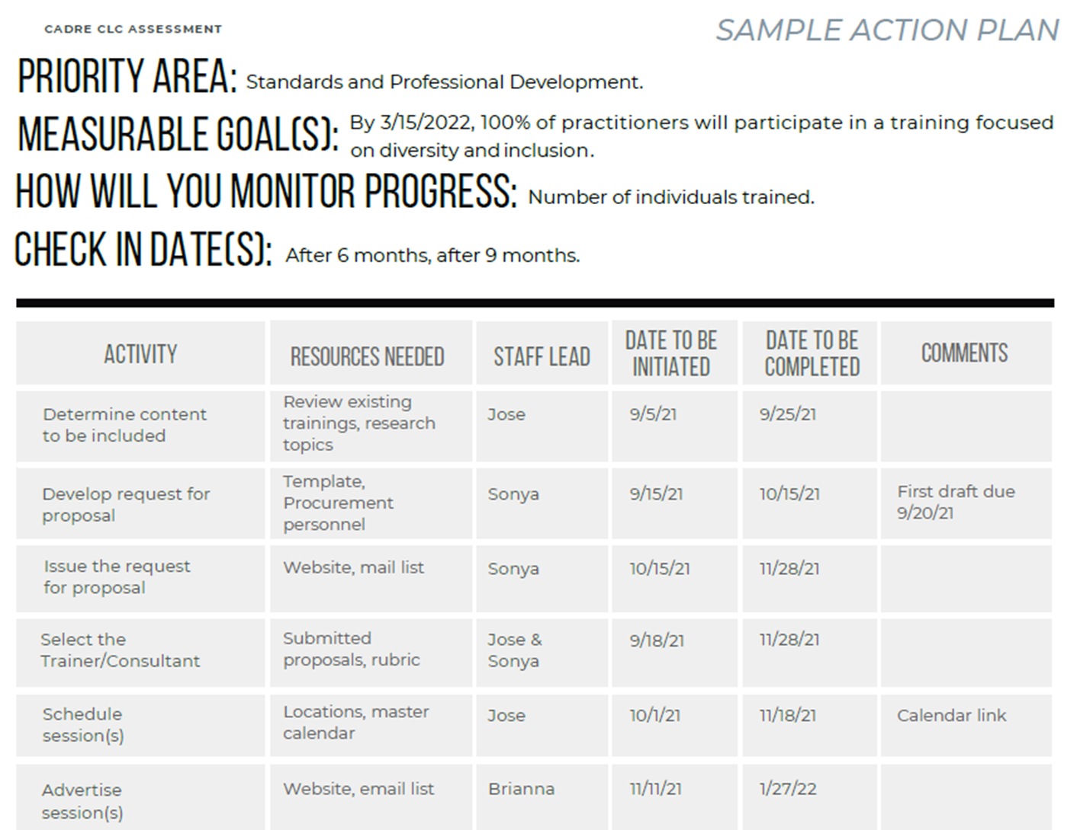
Notes:
This is our Sample Action Plan. It’s customizable to meet the needs of each team.
**Go over parts of the sample plan.
You can use the Action Plan Template for each priority area that has been identified as a goal.

Slide 13
That’s all for Phase 4: Action Planning
Feel free to revisit these recorded webinars throughout your assessment process. They are meant to support you! And as always, feel free to reach out if you need us.
We’re here for you! CADRE@directionservice.org
Notes:
Thanks for joining us for Phase 4: Action Planning.
This is the last of our User Guide Webinar Series. Feel free to rinse and repeat! These resources and CADRE are here for you!

